Slide 1

Optimised Traffic Management
Moiz Zaheer Malik
Jonathan Bahry
Rubayet Kamal
Mofifoluwa Akinwande

Slide 2
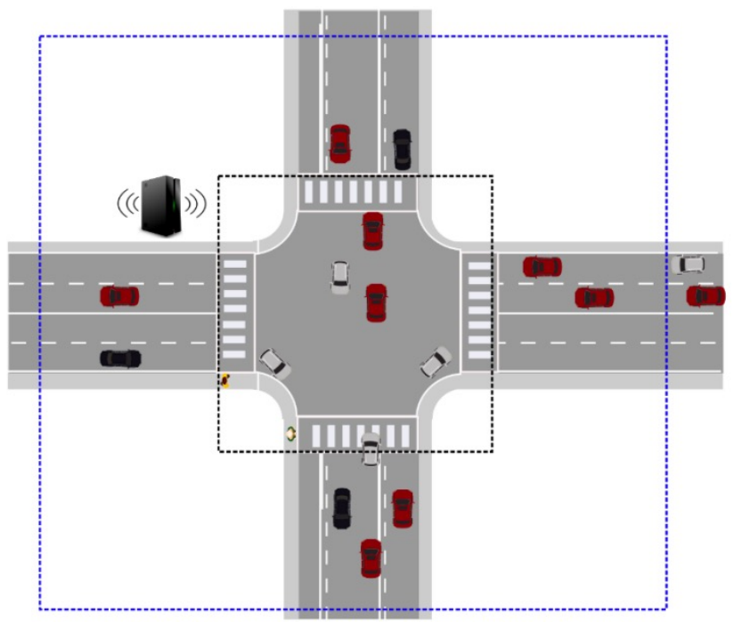
Motivation
Efficient Cross-Traffic Simulation for Autonomous Cars:
Cars to stop at intersection for pedestrians.
Cars to use queue system to avoid collision with other cars.
Implementation with FreeRTOS.
Hardware realisation with VHDL.

Slide 3
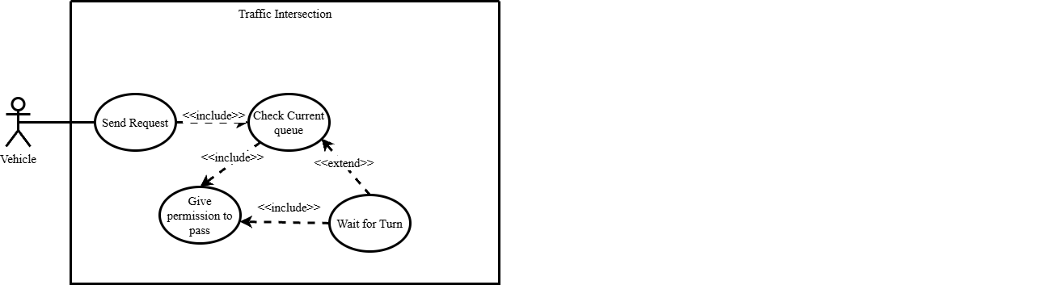
Use Case Diagram

Slide 4
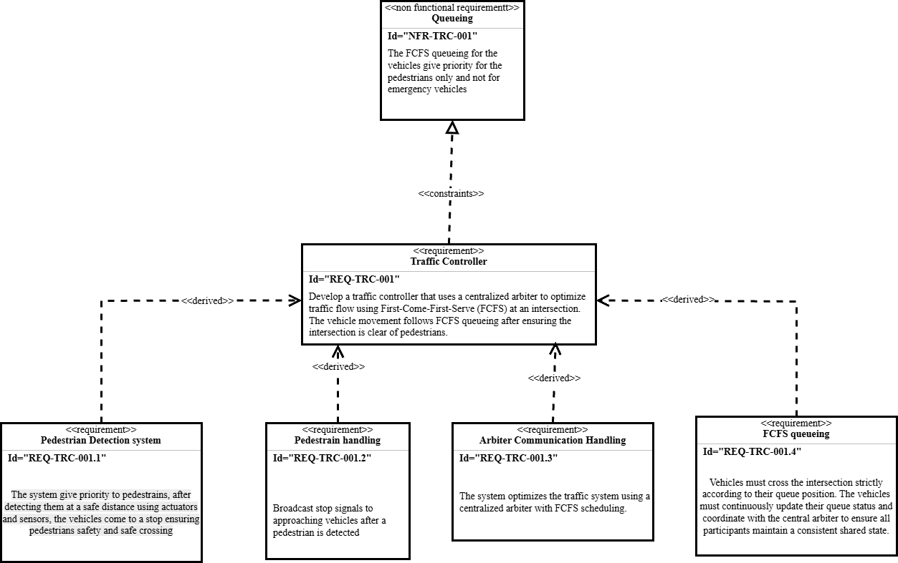
Requirements
Requirement Diagram

Slide 5
Requirements
Requirement Diagram

Slide 6
Requirements
Requirement Diagram

Slide 7
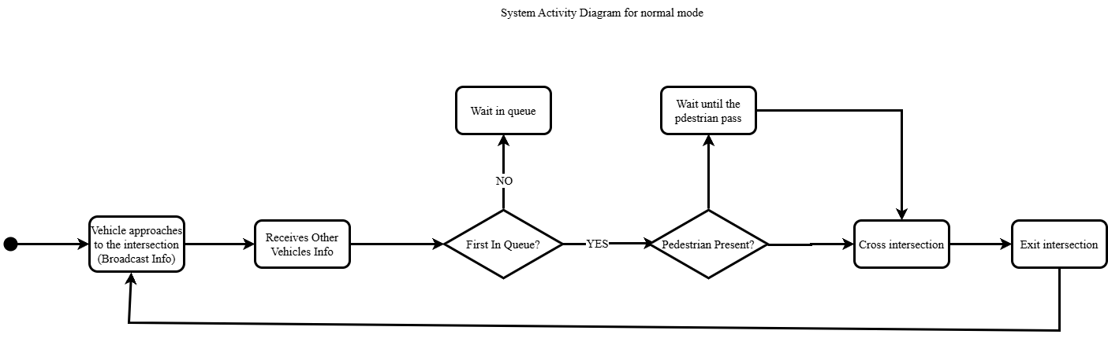
Activity Diagram for Normal Mode

Slide 8
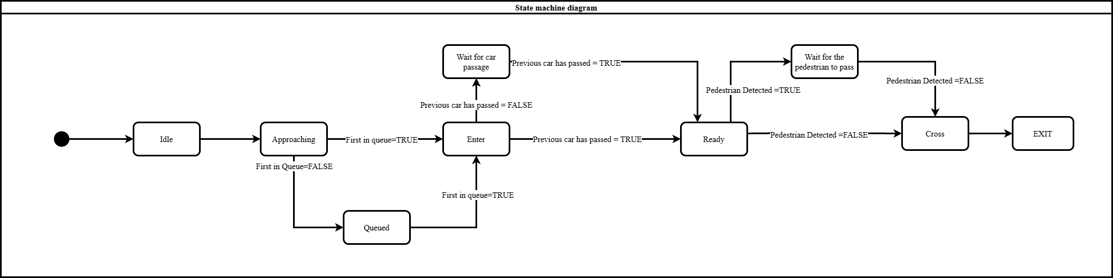
State Machine Diagram

Slide 9
State Machine Diagram

Slide 10
State Machine Diagram

Slide 11
State Machine Diagram

Slide 12
State Machine Diagram

Slide 13
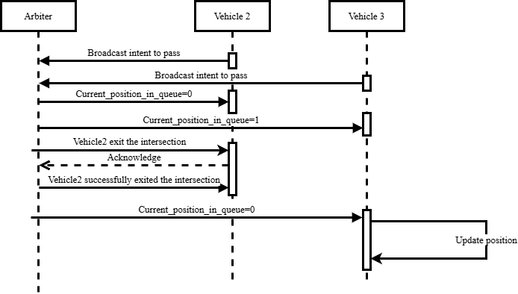
Sequence diagrams for Queue communication

Slide 14
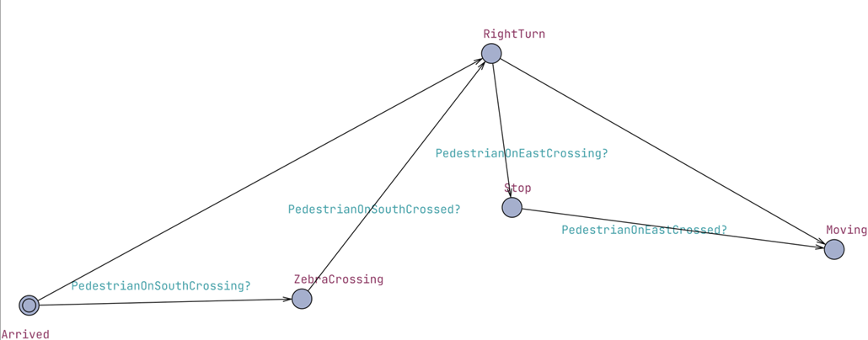
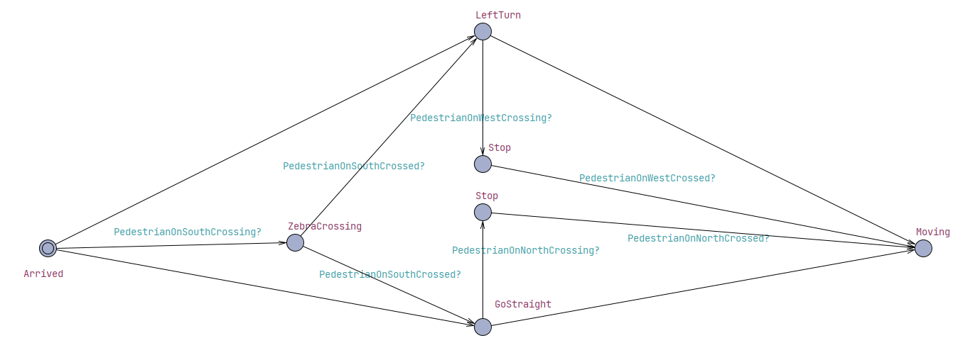
UPPAAL Models for Car Movement in South Lane

Slide 15
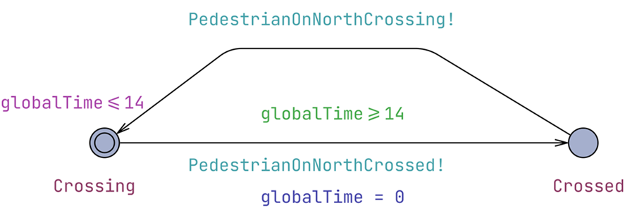
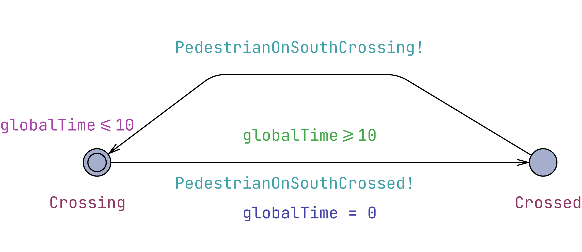
UPPAAL Models for Pedestrian Movement

Slide 16
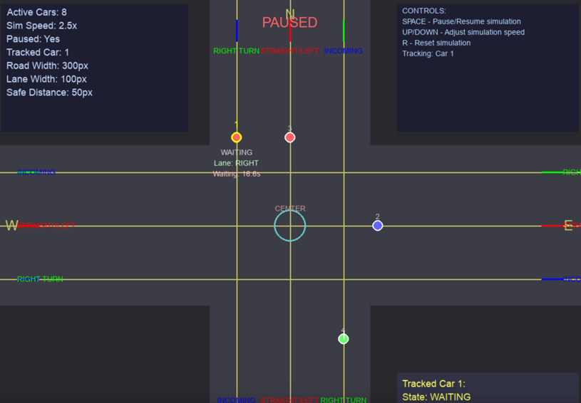
UPPAAL Model for Pedestrian crossing on North

Slide 17
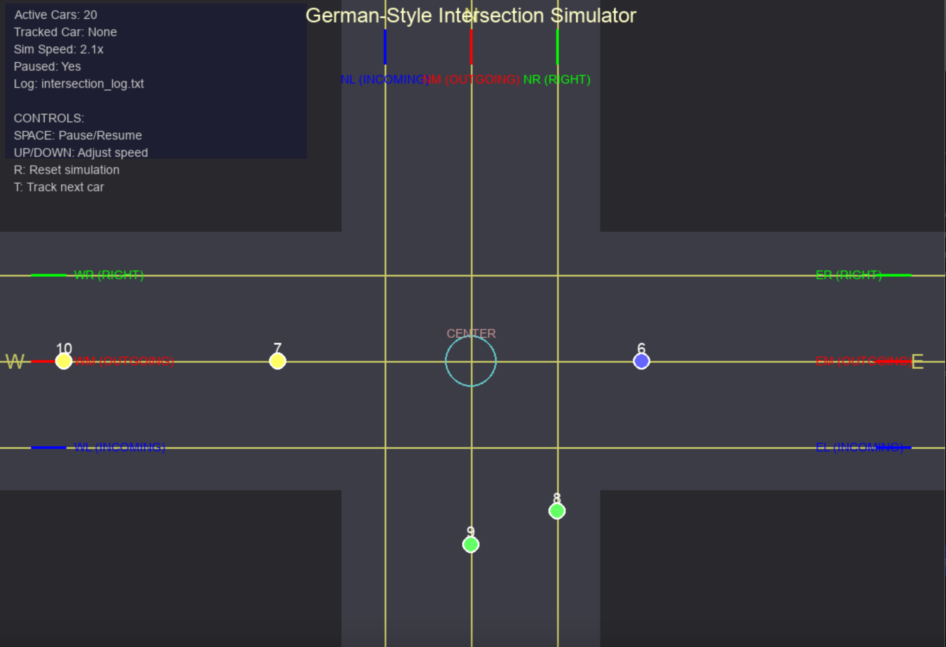
UPPAAL Model for Car in middle-lane of South

Slide 18
UPPAAL Model for Pedestrian crossing on South

Slide 19
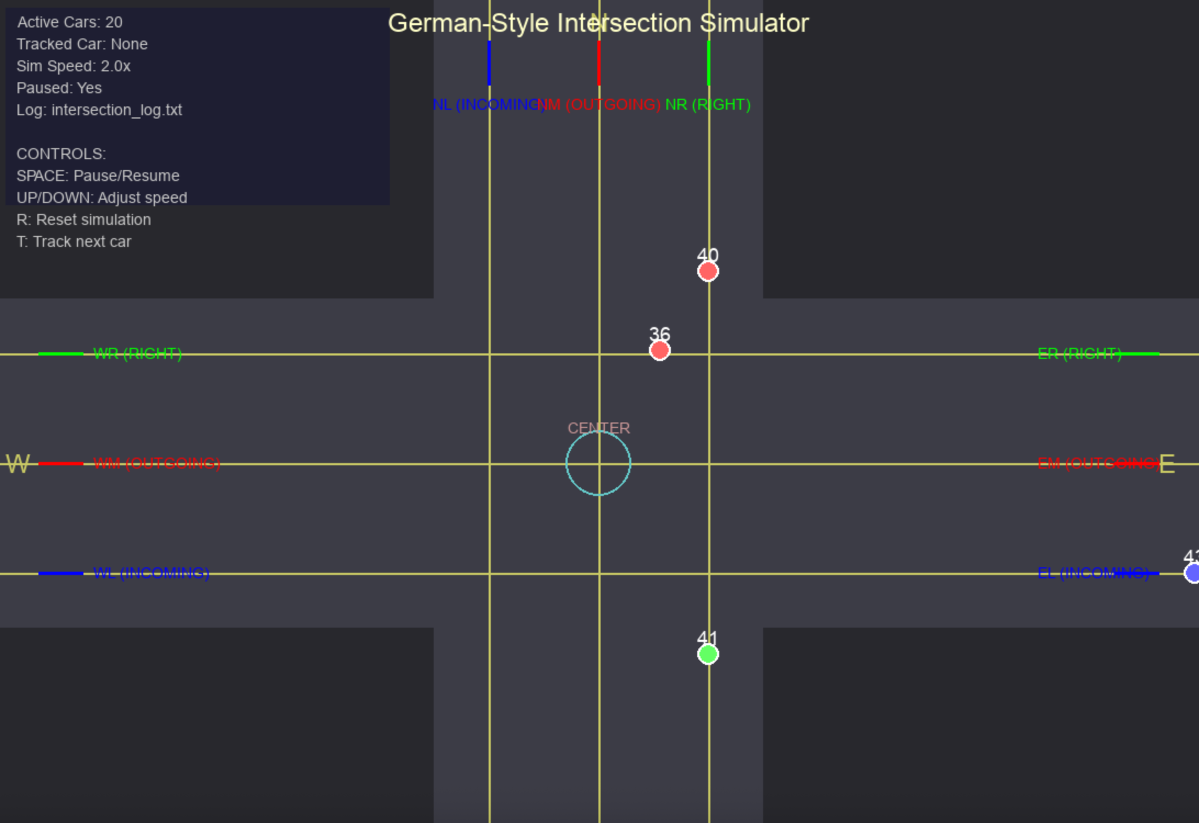

UPPAAL Model for Car in right lane of South

Slide 20
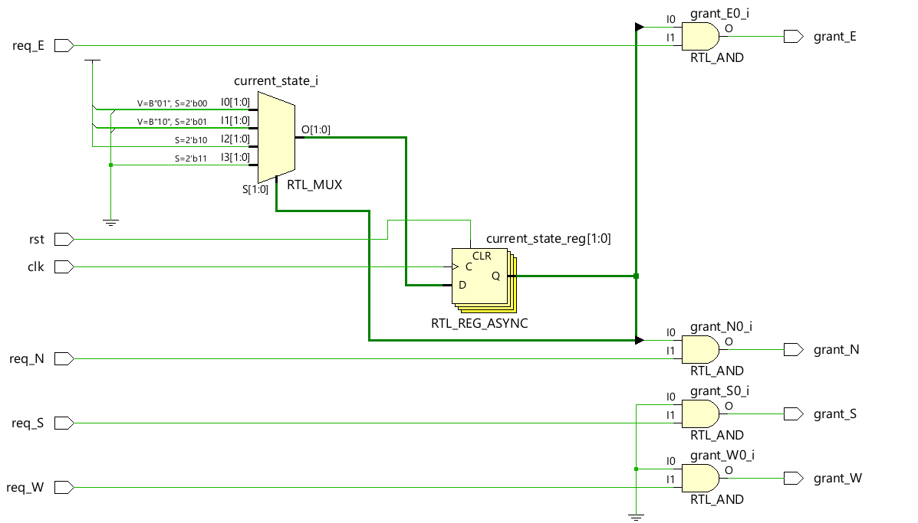
Vehicle Arbiter Module

Slide 21
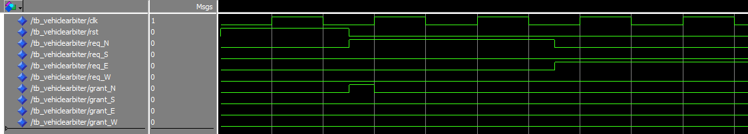
Hardware Implementation: Vehicle Arbiter

Slide 22
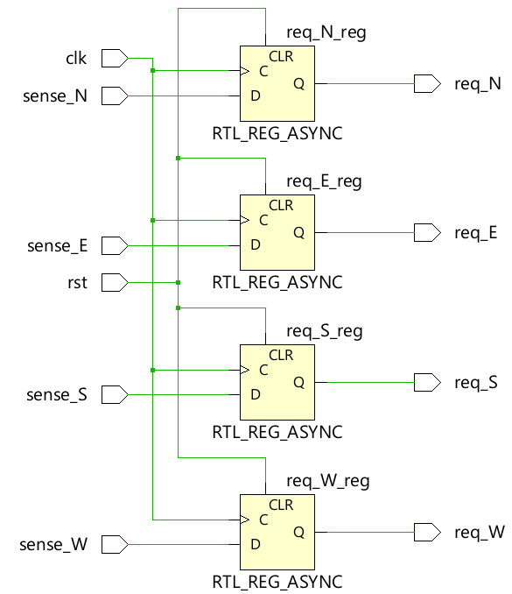
Request Detection Logic

Slide 23
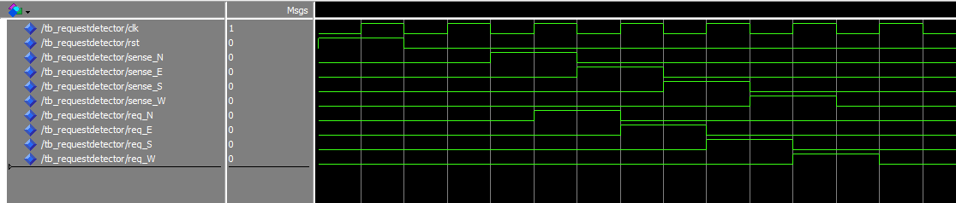
Hardware Implementation: Request Detector

Slide 24
Car Parameters
ClassDiagram
Car
id: int
from: Direction
turn: TurnDirection
arrivalTime: TickType_t
Active:bool
goSem: SemaphoreHandle_t

Slide 25
Software Implementation: FreeRTOS
carTask()
main()
xSemaphoreTake(goSem)
Created
Arrived
Queued
Entering
xQueueSend()
Logs „ARRIVAL“
CROSS_TIME_MS
xSemaphoreGive(GoSem)
Terminated
Exited
vTaskDelete(NULL)

Slide 26
Software Implementation: FreeRTOS
carGeneratorTask()
xTaskCreate(carGeneratorTask, ....)
InitializeCar
TaskCreationFailed
AllocateCar
xTaskCreate != pdPass
pvPortMalloc == True
CheckAllocation
Create CarTask
WaitInterval
pvPortMalloc == False
xTaskCreate == pdPass
AllocationFailed
vTaskDelete(NULL)

Slide 27
Conflicts at Intersection?
Resolved using a “First Come First Serve” (FCFS) technique.
Arbiter Task responsible for:
listening to heads of all queues
deciding which has the earliest arrival time
releasing queues for movement.
Cars can only cross when they receive the go from the Arbiter.

Slide 28
Implementation Algorithm: FCFS
CarGeneratorTask
CarTask
CarTask(Car N)
LogEvent
xTaskCreate(carTask,car)
enqueueCar()
dequeueCar()
xsemaphoreGive()
waitOnSemaphore()
xSemaphoreGive == true
Log_event(„start“)
performAction()
Log_event(„Done“)

Slide 29
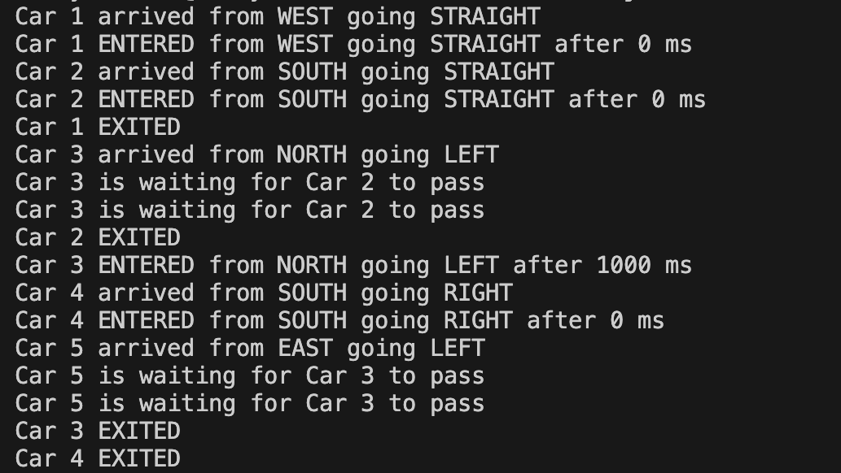
Progress

Slide 30
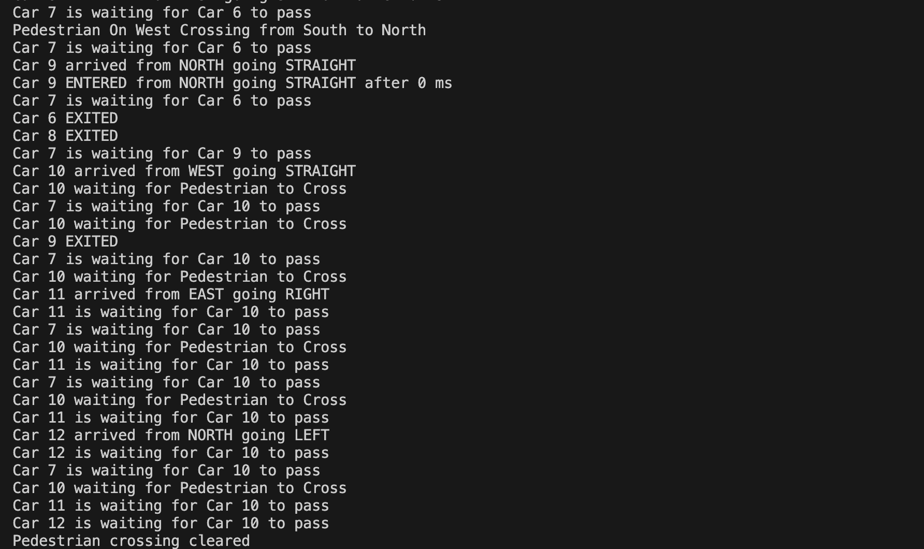
Challenges

Slide 31
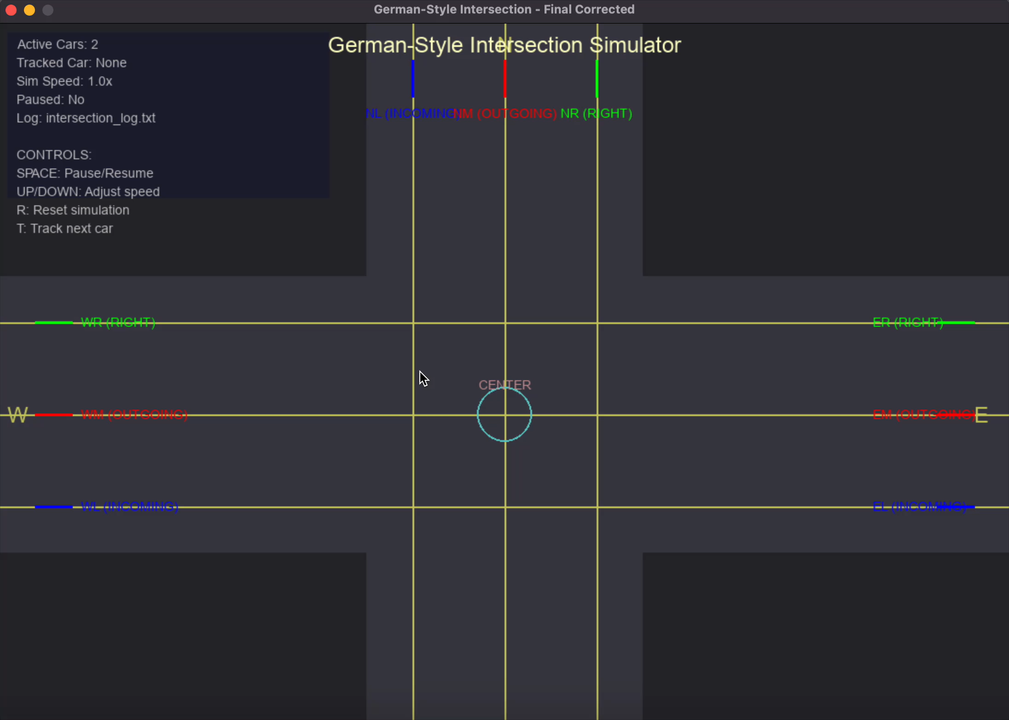
Simulation (Unsuccessful Approach)

Slide 32
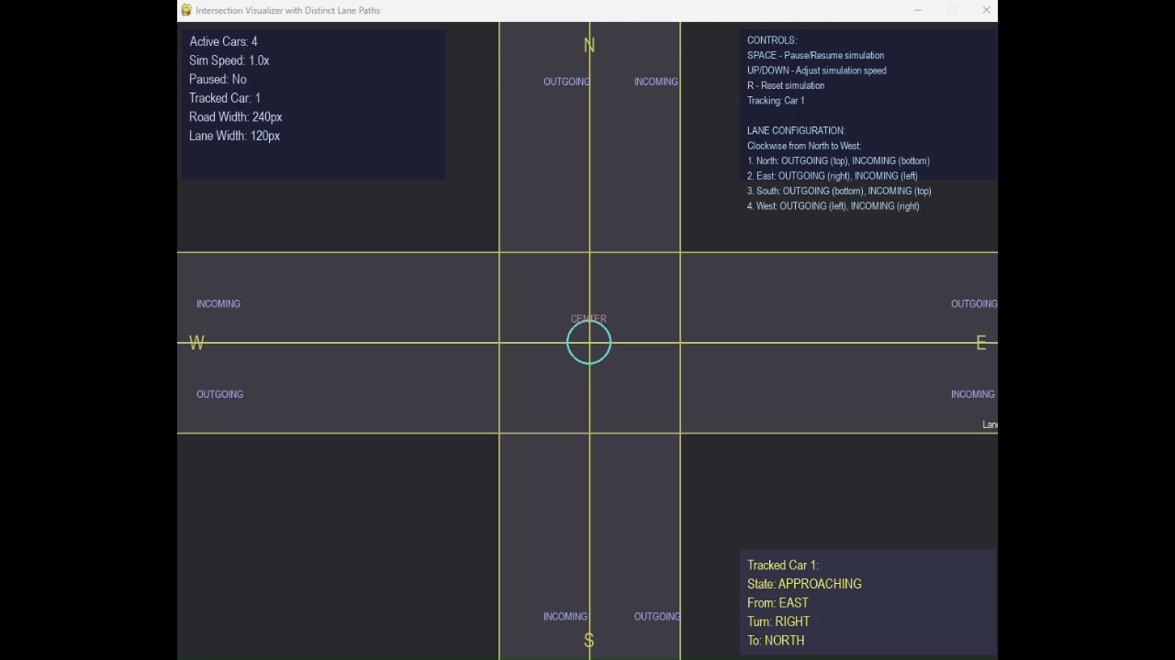
Simulation (Working Approach)

Slide 33
Summary and Future Work
Implemented a four lane cross simulation using queues.
Software (FreeRTOS): Used an Arbiter Task employing FCFS to resolve conflicts at Intersection.
Hardware (VHDL): Designed request detection logic and vehicle arbiter module on hardware.
Future Work:
Pedestrians detection.
Scaling lanes.
Emergency vehicle.

